Slide 1
Probability distributions
What are distributions?
How to identify correct distribution of the data?

Slide 2
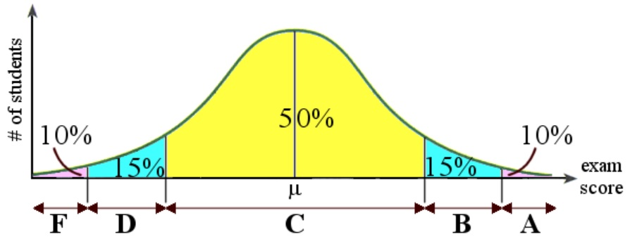
Probability distributions
A statistical model that shows possible outcomes of a particular event or course of action as well as the statistical likelihood of each event.
What do we mean by “Grades in a course follows a normal distribution”?
What do we mean by “Sales for the next month may be uniformly distributed”?

Slide 3
How to go about this?
How do we use the collected business data (sales volume, loan defaulters, Salary hikes in an organization, etc.)?
The data values themselves are used directly in the simulation. This is called trace-driven simulation.
“Fit” a theoretical distribution to the data (and check whether that “fit” is good!).
The data values could be used to define an empirical distribution function in some way.

Slide 4
What are these empirical distributions?
Using the data, we build our own distributions.
How does one build a distribution?
Essential building blocks:
Define the density/distribution functions.
Estimate the parameters (mean, standard deviation, etc.)

Slide 5
Empirical distributions
For ungrouped data:
Let X_{(i)} denote the ith smallest of the X_{j}’s so that:

Slide 6
Empirical distributions
For grouped data:
Suppose that n X_{j}’s are grouped in k adjacent intervals [a₀,a₁), [a₁,a₂),…[a_{k-1},a_{k}) so that jth interval contains n_{j} observations. n₁+ n₂+… n_{k} = n.
Let a piecewise linear function G be such that G(a₀) = 0, G(a_{j}) = (n₁+ n₂+… n_{j}) /n, then:

Slide 7
The three approaches…
Approach 1 is used to validate simulation model when comparing model output for an existing system with the corresponding output for the system itself.
Two drawbacks of approach 1: simulation can only reproduce only what happened historically; and there is seldom enough data to make all simulation runs.
Approaches 2 and 3 avoid these shortcomings so that any value between minimum and maximum can be generated. So approaches 2 and 3 are preferred over approach 1.
If theoretical distributions can be found that fits the observed data (approach 2), then it is preferred over approach 3.

Slide 8
Approach 3 v/s Approach 2
Empirical distribution may have some irregularities if small number of data points are available. Approach 2 smoothens out the data and may provide information on the overall underlying distribution.
In approach 3, it is usually not possible to generate values outside the range of observed data in the simulation.
If one wants to test the performance of the simulated system under extreme conditions, that can not be done using approach 3.
There may be compelling (physical) reasons in some situations for using a particular theoretical distribution. In that case too, it is better to get empirical support for that distribution from the observed data.

Slide 9
Business example
Data points: 217.
For these data points, we need to fit a probability distribution.

Slide 10
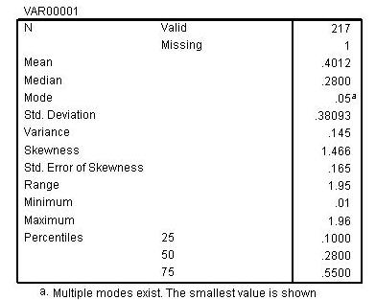
Summary statistics

Slide 11
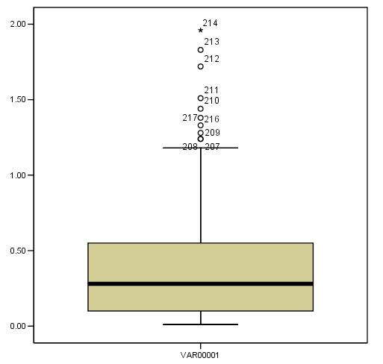
Box plot

Slide 12
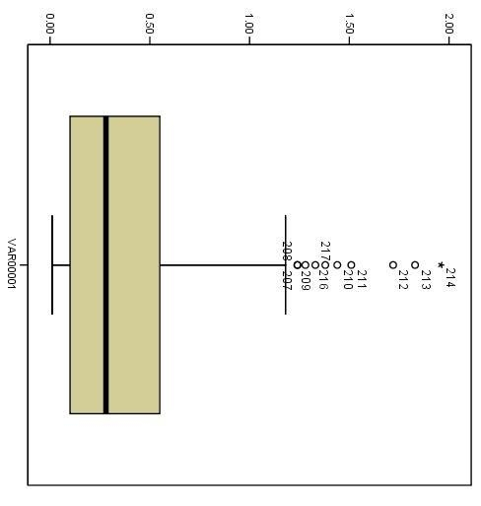
Box plot

Slide 13
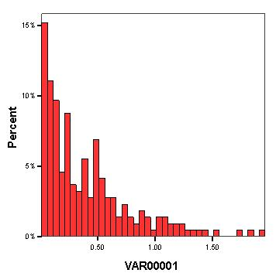
Histograms

Slide 14
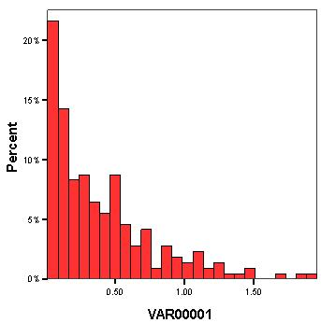
Histograms

Slide 15
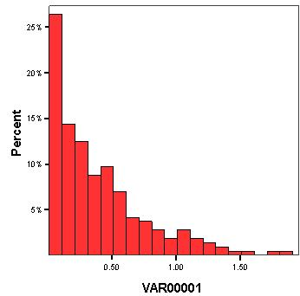
Histograms

Slide 16
Clues from summary statistics
For the symmetric distributions mean and median should match. In the sample data, if these values are sufficiently close to each other, we can think of a symmetric distribution (e.g. normal).
Coefficient of variation (cv): (ratio of std dev and the mean) for continuous distributions. The cv = 1 for exponential dist. If the histogram looks like a slightly right-skewed curve with cv >1, then lognormal could be better approximation of the distribution.
Note: For many distributions cv may not even be properly defined. When? Examples?

Slide 17
Clues from summary statistics
Lexis ratio: same as cv for discrete distributions.
Skewness (ν): measure of symmetry of a distribution. For normal dist. ν = 0. For ν>0, the distribution is skewed towards right (exponential dist, ν = 2). And for ν<0, the distribution is skewed towards left.

Slide 18
Parameter estimation
Once distribution is guessed, the next step is estimating the parameters of the distribution.
Each distribution has a set of parameters.
Normal distribution has mean and standard deviation
Exponential distribution has a “λ”.
Most common method of parameter estimation: MLE (What is this?)

Slide 19
Goodness-of-fit
For the input data we have, we have assumed a probability distribution.
We also have estimated the parameters for the same.
How do we know this fitted distribution is “good enough?”
It can be checked by several methods:
Frequency comparison (a bit technical)
Probability plots (visual tool)
Goodness-of-fit tests (statistical test of goodness. Very widely used).

Slide 20
Probability plots
Q-Q plot: Quantile-quantile plot
Graph of the q_{i}-quantile of a fitted (model) distribution versus the q_{i}-quantile of the sample distribution.
If F^(x) is the correct distribution that is fitted, for a large sample size, then F^(x) and F_{n}(x) will be close together and the Q-Q plot will be approximately linear with intercept 0 and slope 1.
For small sample, even if F^(x) is the correct distribution, there will some departure from the straight line.

Slide 21
Probability plots
P-P plot: Probability-Probability plot.
It is valid for both continuous as well as discrete data sets.
If F^(x) is the correct distribution that is fitted, for a large sample size, then F^(x) and F_{n}(x) will be close together and the P-P plot will be approximately linear with intercept 0 and slope 1.

Slide 22
Probability plots
The Q-Q plot will amplify the differences between the tails of the model distribution and the sample distribution.
Whereas, the P-P plot will amplify the differences at the middle portion of the model and sample distribution.

Slide 23
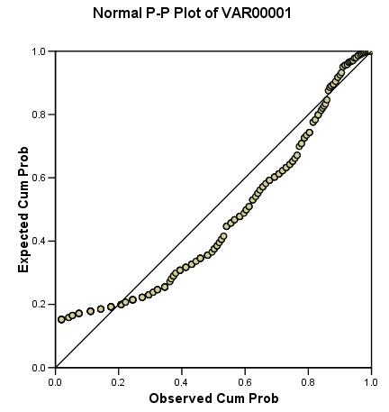
Probability plots: Dataset

Slide 24
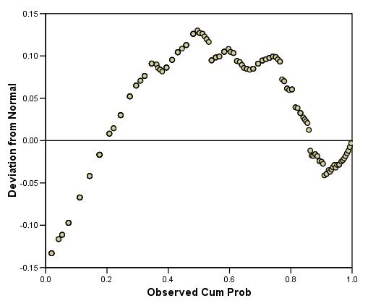
Probability plots: Dataset

Slide 25
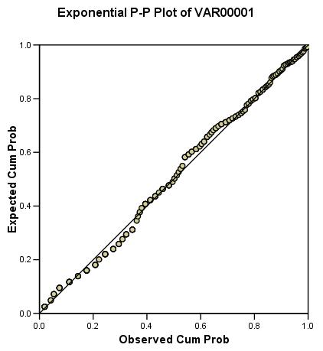
Probability plots: Dataset

Slide 26
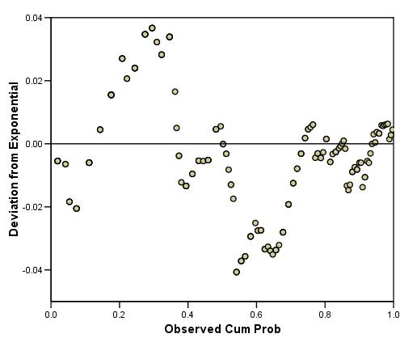
Probability plots: Dataset

Slide 27
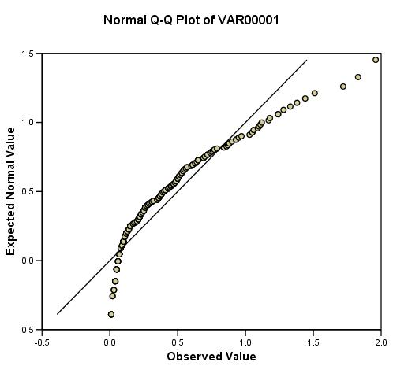
Probability plots: Dataset

Slide 28
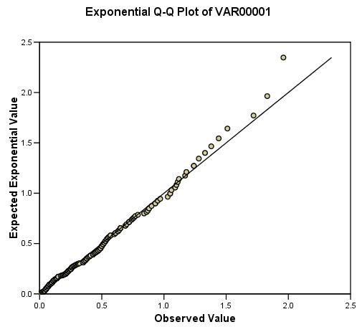
Probability plots: Dataset

Slide 29
Goodness-of-fit tests
A goodness-of-fit test is a statistical hypothesis test that is used to assess formally whether the observations X₁, X₂, X₃…X_{n} are an independent sample from a particular distribution with function F^.
H₀: The X_{i}’s are IID random variables with distribution function F^.
Two famous tests:
Chi-square test
Kolmogorov - Smirnov test

Slide 30
Chi-square test
Applicable for both, continuous as well as discrete, distributions.
Method of calculating chi-square test statistic:
Divide the entire range of fitted distribution into k adjacent intervals -- [a₀ ,a₁), [a₁,a₂),…[a_{k-1},a_{k}), where it could that a₀ = -∞ in which case the first interval is (-∞,a₁) and/or a_{k} = ∞.
N_{j} = # of X_{i}’s in the jth interval [a_{j-1},a_{j}), j= 1,2…n.
Next, we compute the expected proportion of X_{i}’s that would fall in the jth interval if we were sampling from fitted distribution

Slide 31
Chi-square test
Finally the test statistic is calculated as:

Slide 32
Chi-square test
This calculated value of the test statistic is compared with the tabulated value of chi-square distribution with k-1 df at 1-α level of significance.

